Slide 1

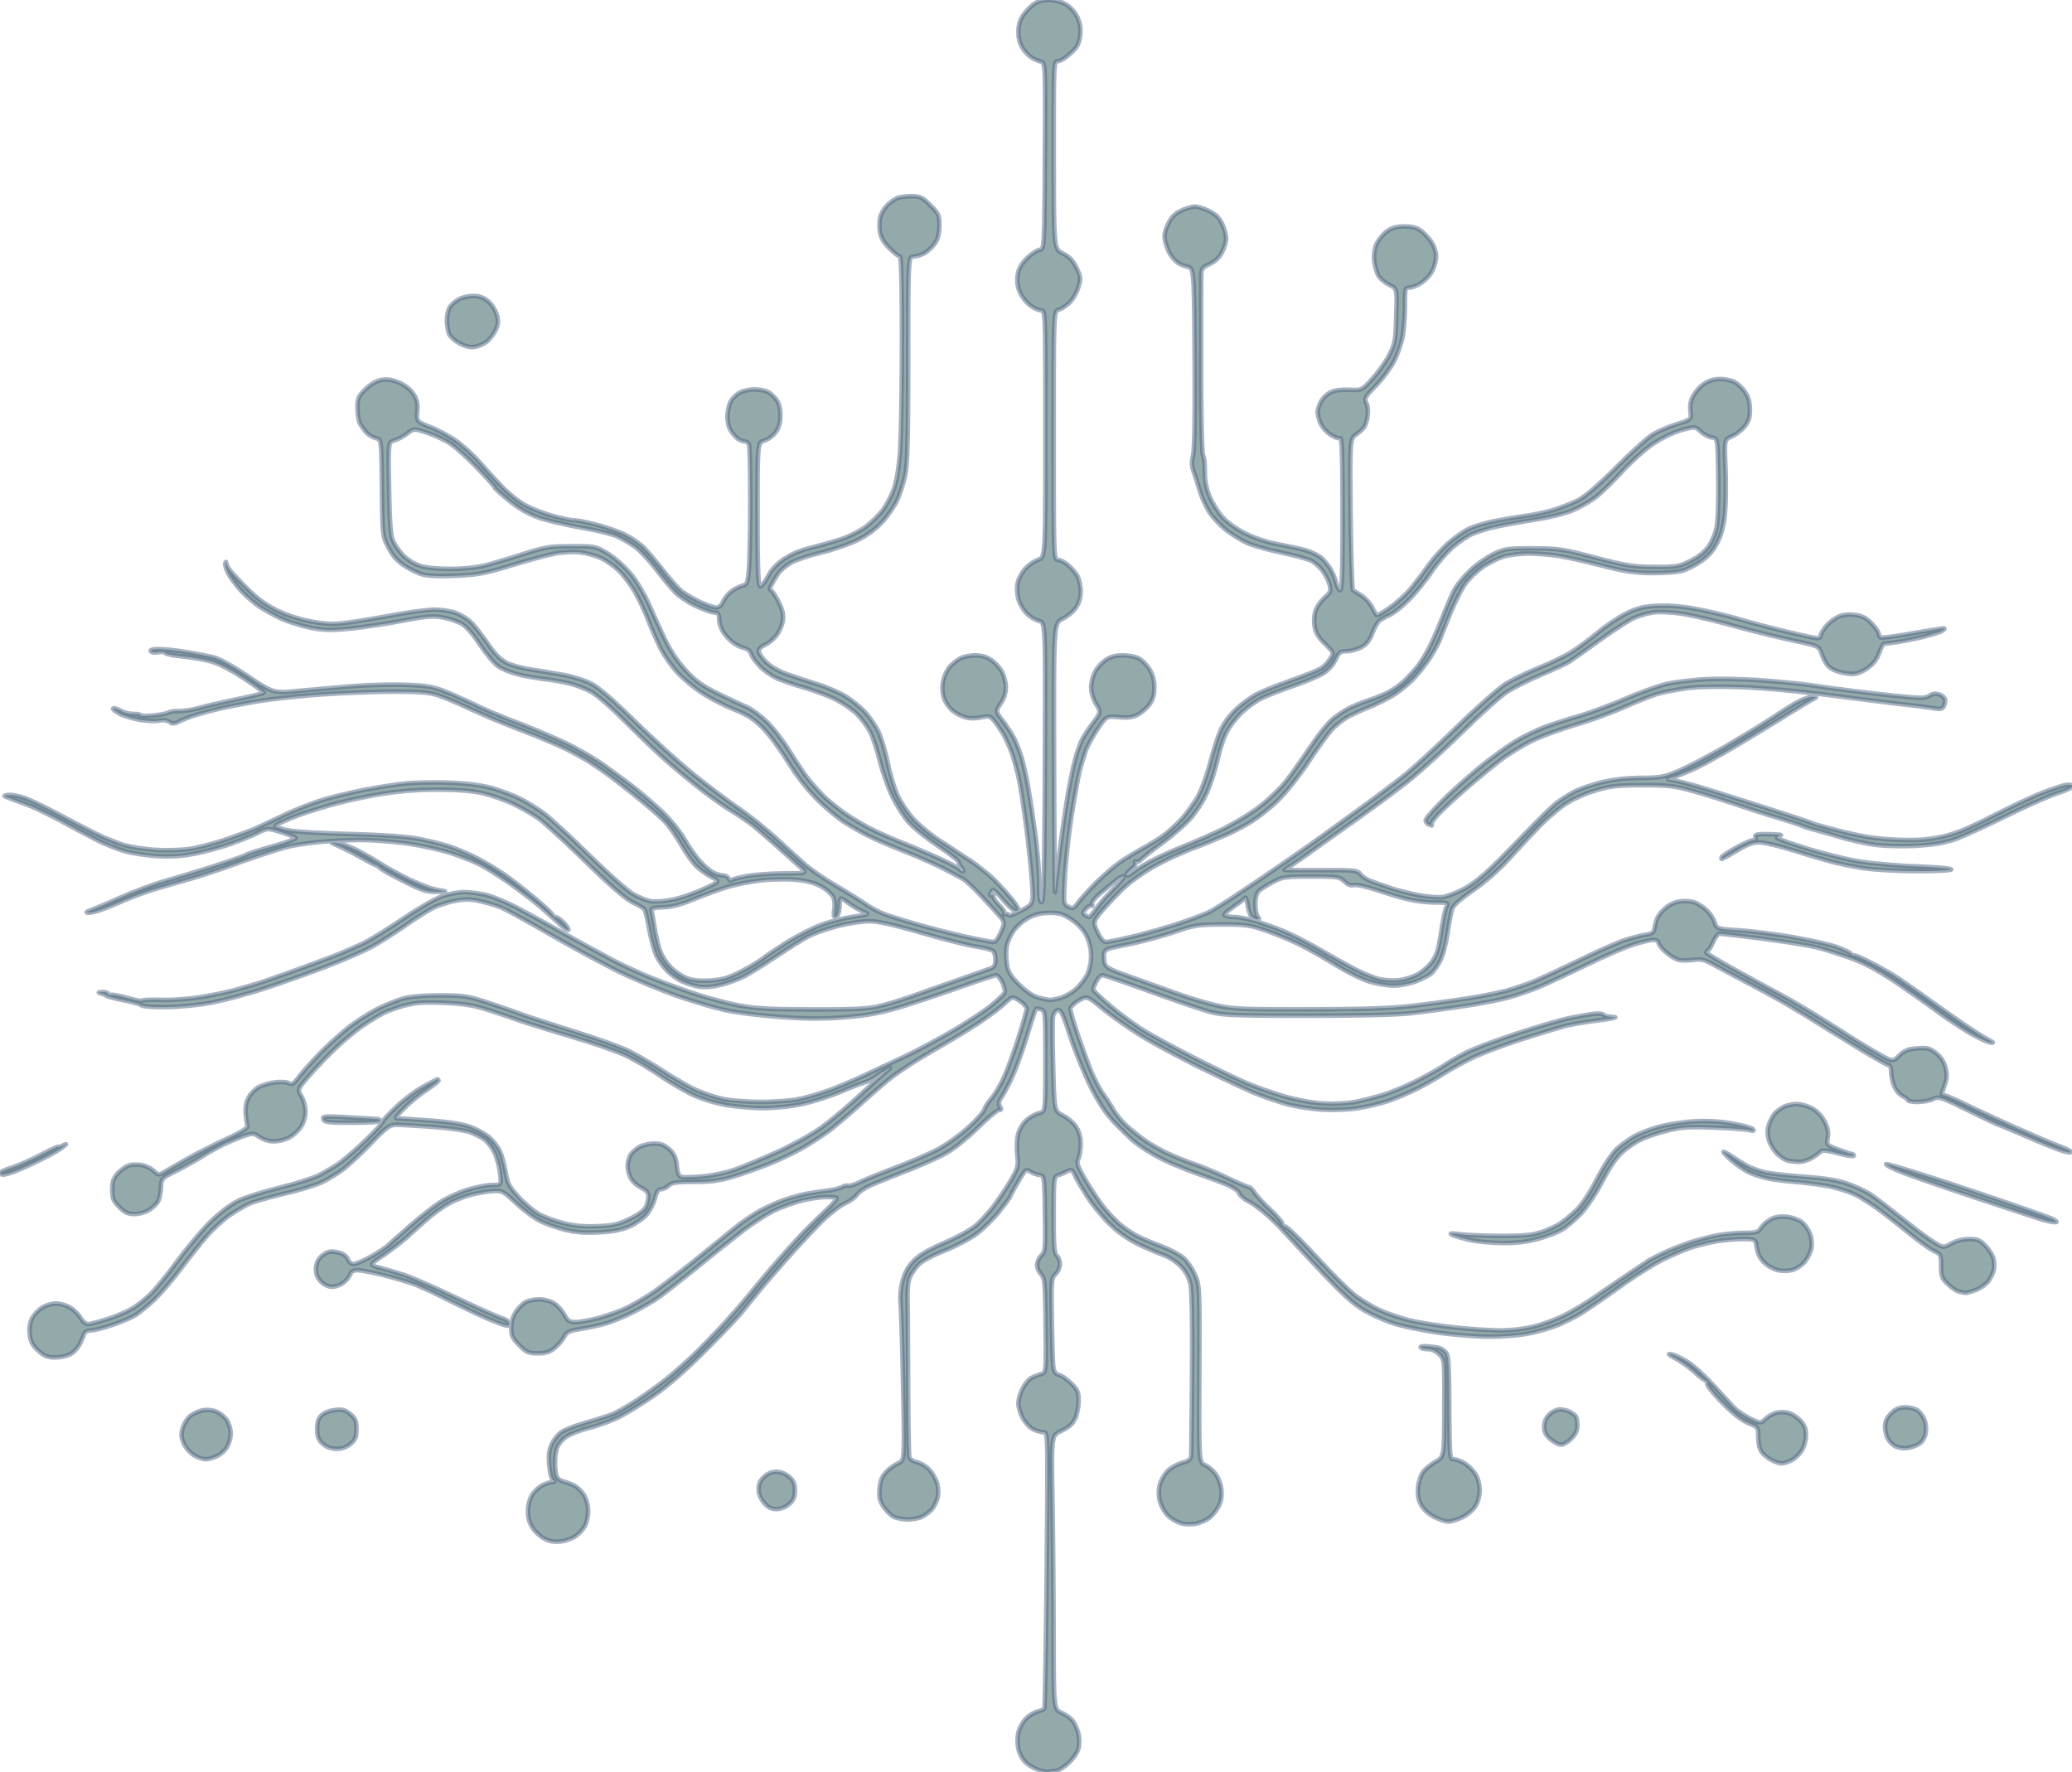
Quantum Machine Learning for Conspicuity Detection in Production
Team PlanQ
Cristian Ilie
Womanium Quantum+AI Project

Slide 2
Introduction
Welcome to my presentation on Quantum Machine Learning!
I'm thrilled to share my progress on this exciting project, which involves solving complex challenges merging. Over the next few slides, I'll take you through the 4 challenges I’ve successfully completed.
Womanium Quantum+AI Project

Slide 3
Challenge 1 Pennylane Codebook
For the first challenge, I focused on understanding and implementing fundamental concepts in quantum computing using Pennylane. Specifically, I worked with qubits, quantum gates, quantum rotations, unitaries, superposition, state preparation, measurement, and two-qubit gates.
I followed the codebook that covered these topics, providing a solid foundation for further exploration of quantum machine learning. This challenge allowed me to delve into the theoretical aspects of quantum computing and lay the groundwork for more complex applications in the subsequent challenges.
Womanium Quantum+AI Project

Slide 4
Challenge 2 Variational Quantum Classifier
Learned about elementary components of a VQC , the layers and the trainable parameters
Understood how to train and test a VQC using Pennylane
Applied different encoding schemes to fit various problems
Explored different architectures and hyperparameters to understand the optimization process
Womanium Quantum+AI Project

Slide 5
Challenge 3 Quanvolutional Neural Network
Learnt about the principles and benefits of combining quantum computing with deep learning
Understood how ‘quanvolution’ differs from traditional convolutional neural networks
Set a new goal of learning to train the quantum kernels
Womanium Quantum+AI Project

Slide 6
Challenge 4 Sine Function
Designed a quantum machine learning algorithm that can learn the representation of a sine function
Explored the possibilities of using this algorithm for reproducing unseen samples
Discussed the challenge of optimizing the algorithm with respect to the number of shots
Explored a strategy of increasing the number of qubits and parameters for each qubit
Achieved improved performance through this optimization
Womanium Quantum+AI Project

Slide 7
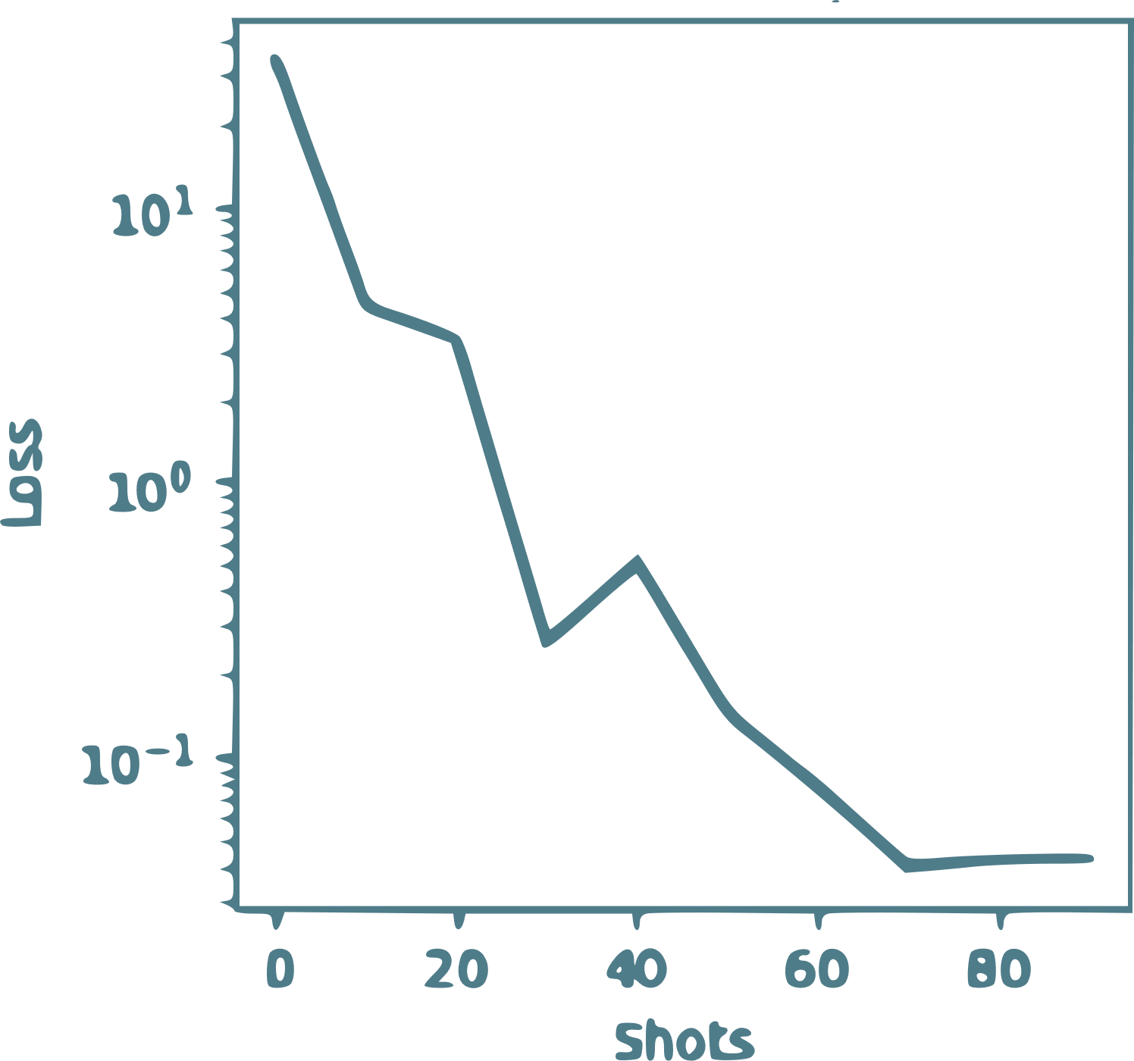
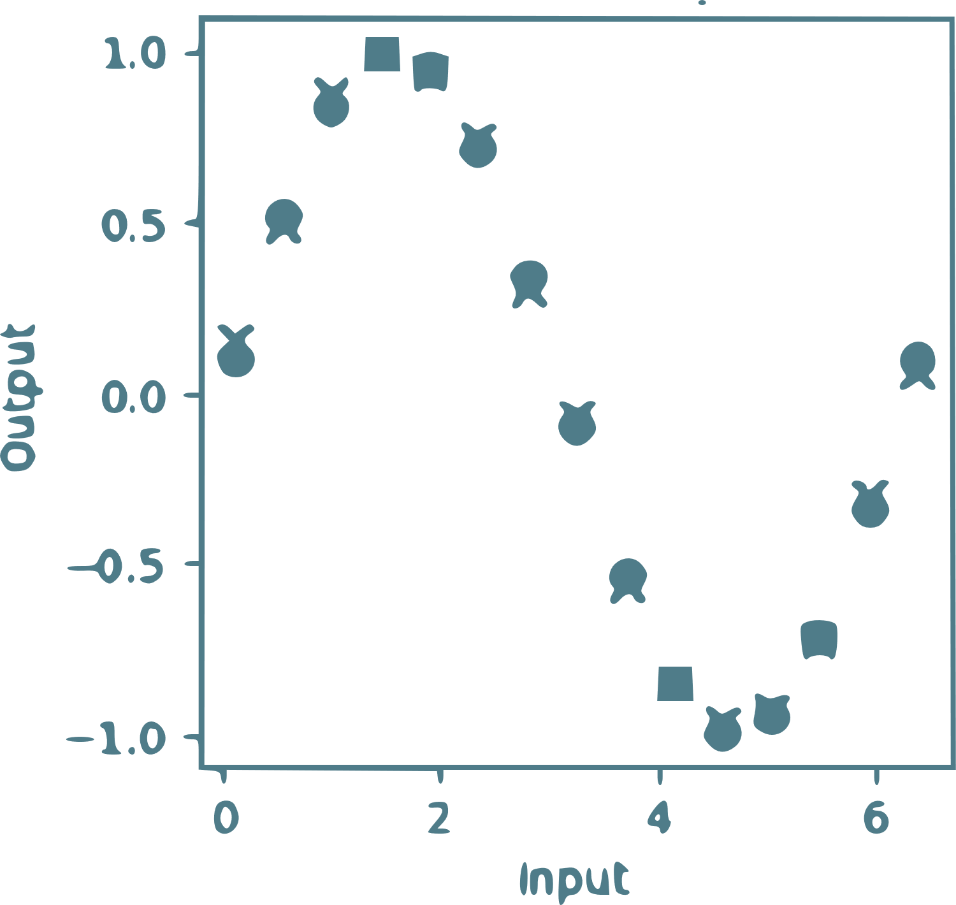
Challenge 4 Results and Discussion
Presented the results of evaluating the algorithm on unseen samples
Discussed the implications and the trade-offs within our approach
Womanium Quantum+AI Project

Slide 8
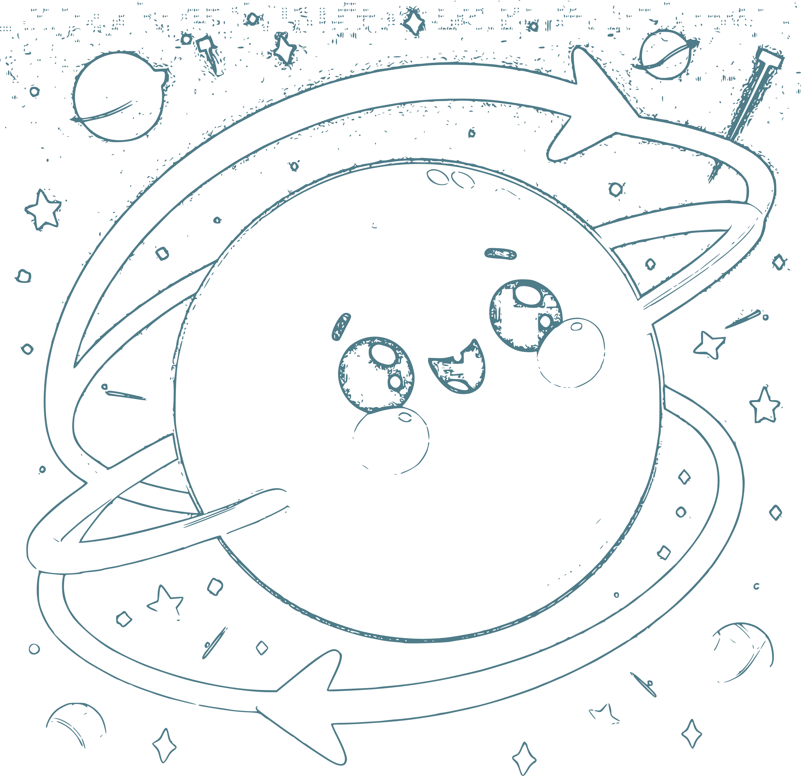
Thank you!
Image generated with DALL-E 3
Womanium Quantum+AI Project

